Slide 1

Daria Solodey
Methodologist, course creator, English teacher

Slide 2
🔥
Our goal
Pass a job interview
Our rules:
Turn on your camera
Set up your microphone
Be active
Notes:
Если вам не хватило места, вы можете здесь написать развернутый комментарий.

Slide 3

Lesson Plan:
Practise answering the questions:
Why do you want to work here?
Notes:
Развернутый комментарий.

Slide 4
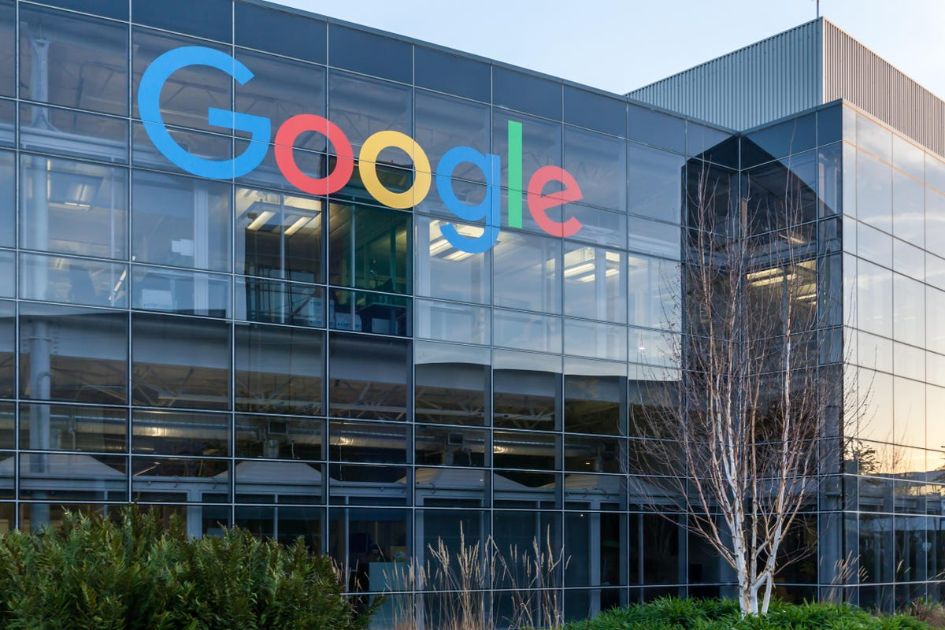
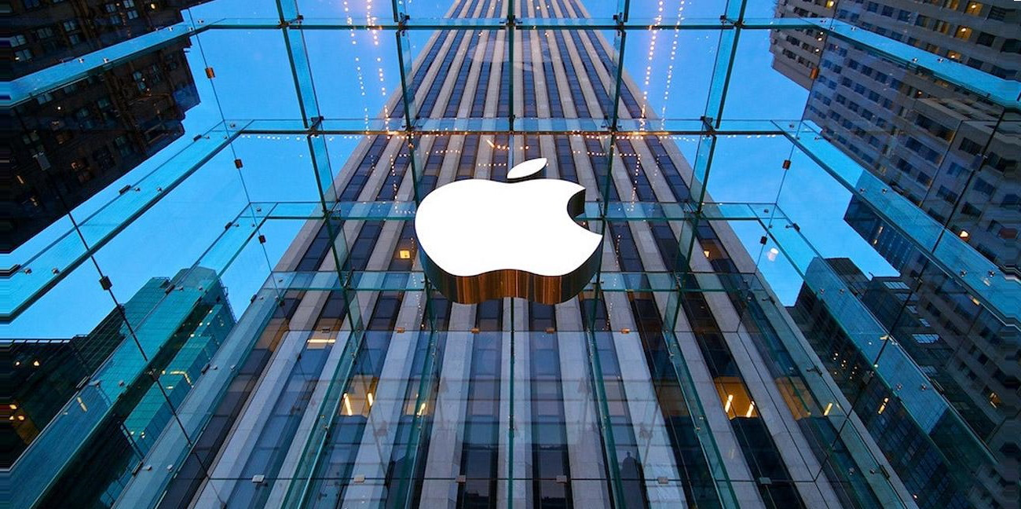

Which company would you like to work for? Why?
I would like to work for ….
BECAUSE....

Slide 5
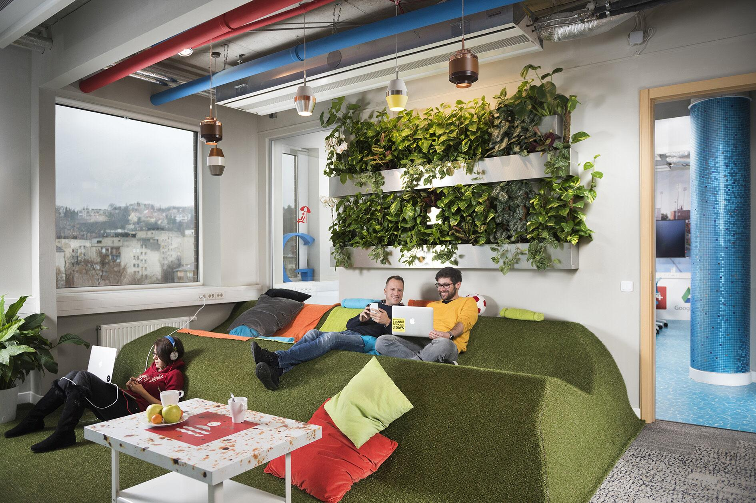
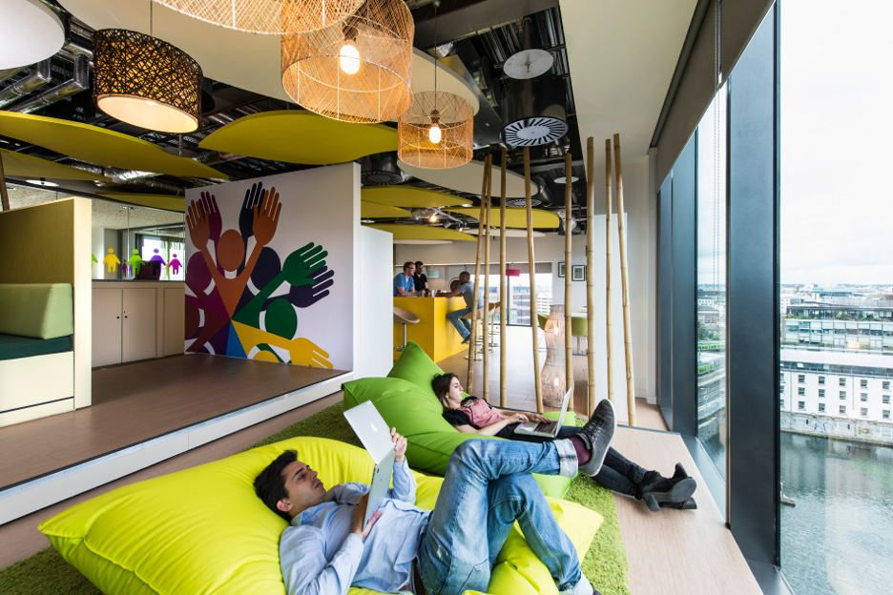
Why does Google create such working conditions for their employees? Do you think people work more productively if their working conditions are good? Do working conditions affect your productivity?

Slide 6
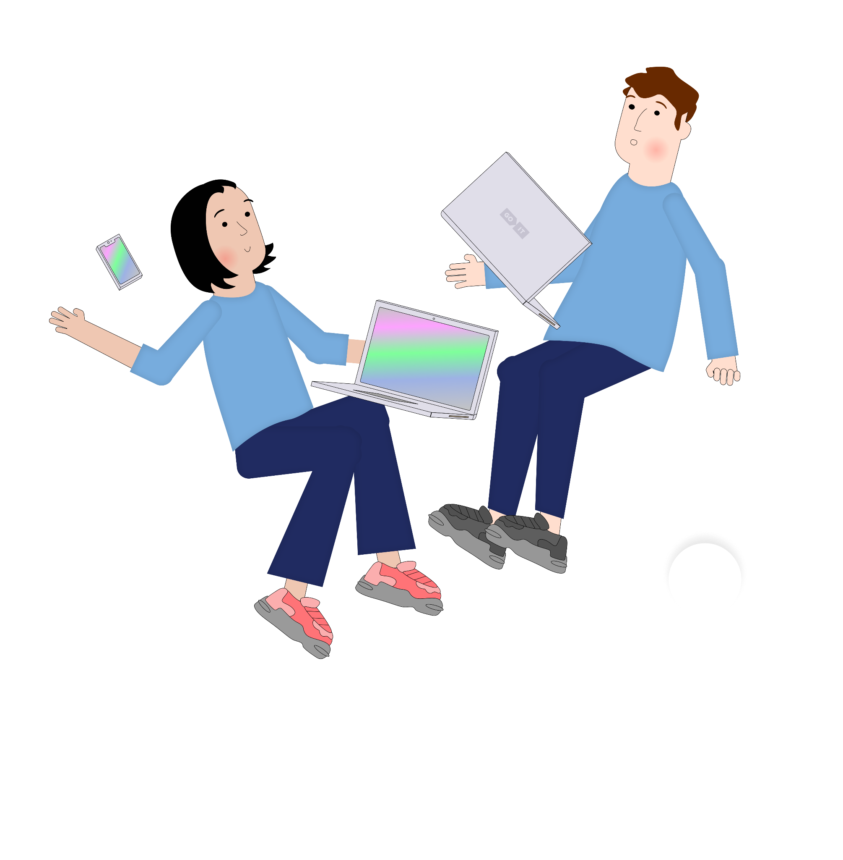
Let’s watch the video and find out:
What’s it like to work for Google?

Slide 7
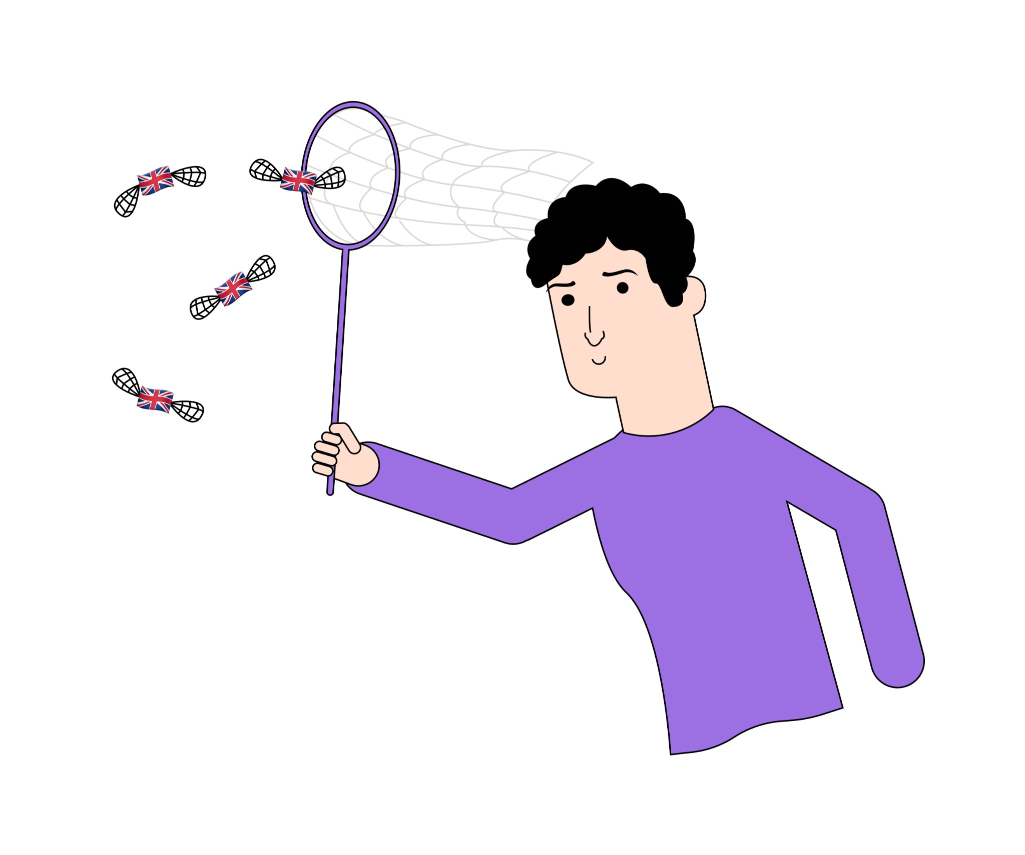
Let’s check how well you learnt the vocabulary!
Notes:
Active link

Slide 8

Answer the questions
Why do people like working for Google?
Why does Google try this hard
to create such working environment?
What are Google’s core values?
Why do you think so?
Which of these answers can you relate to?

Slide 9
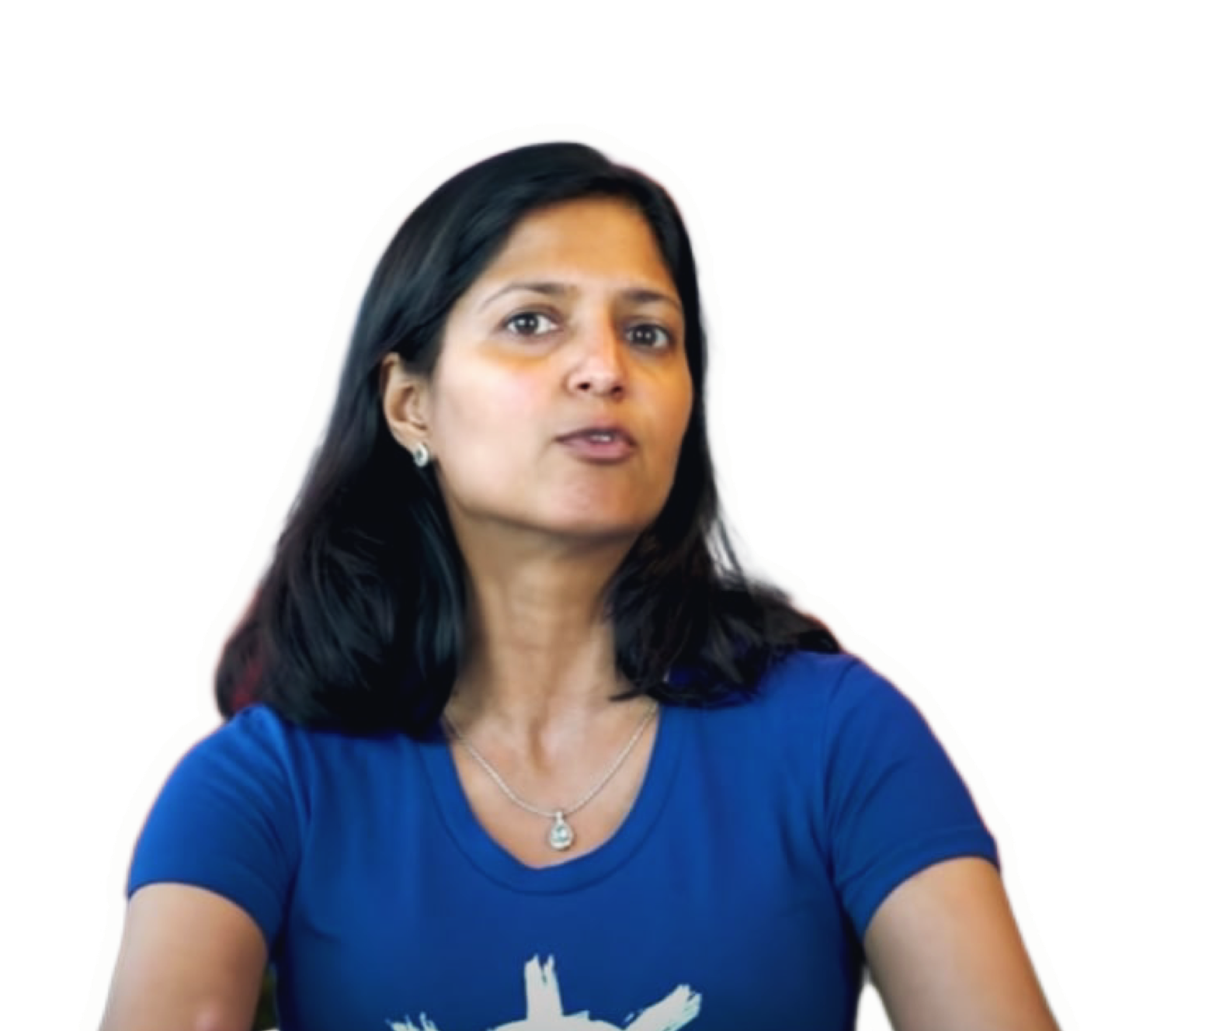
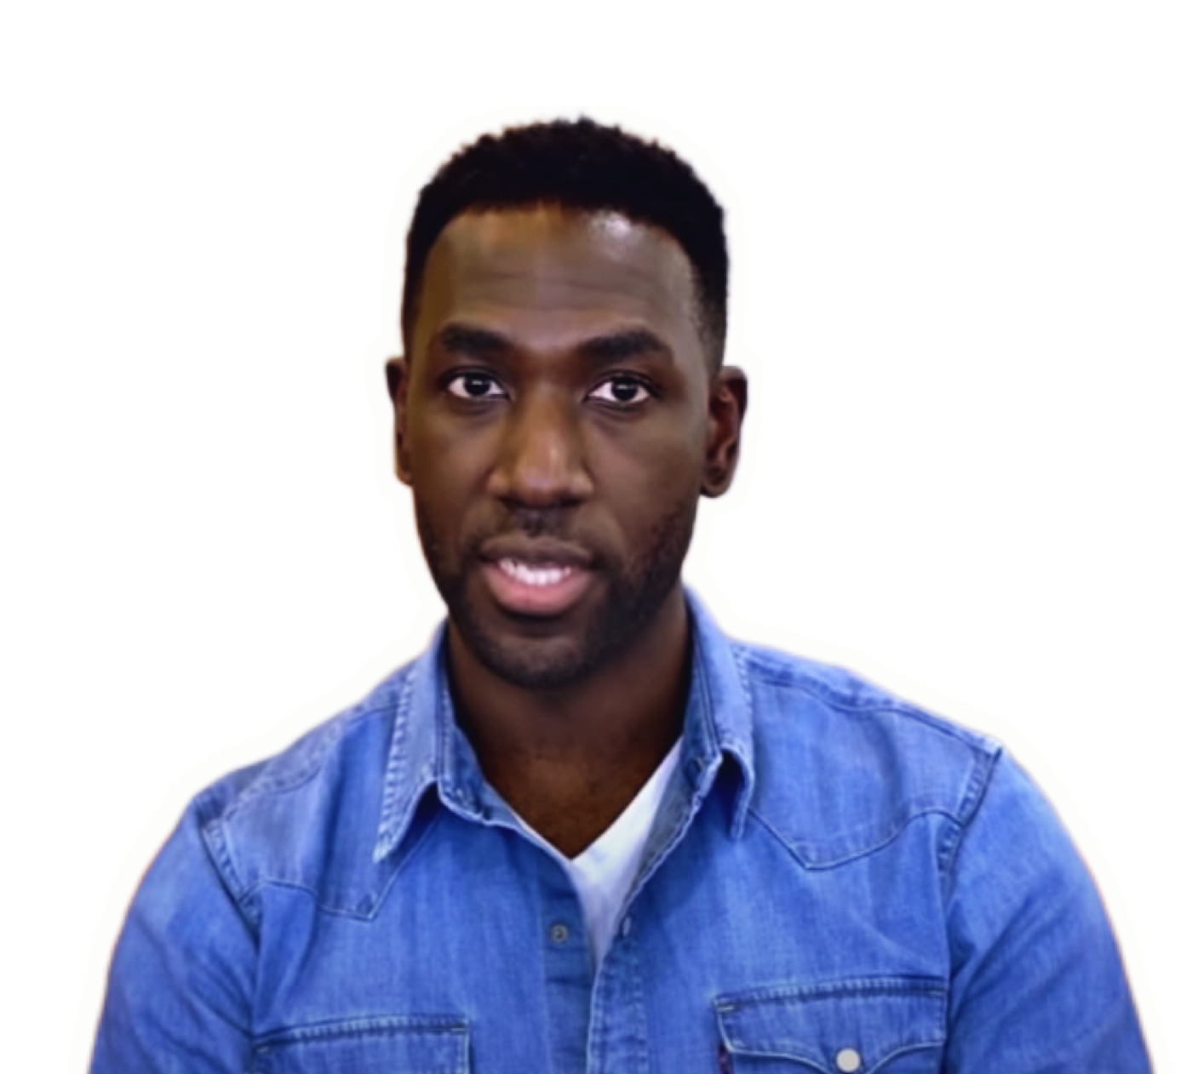

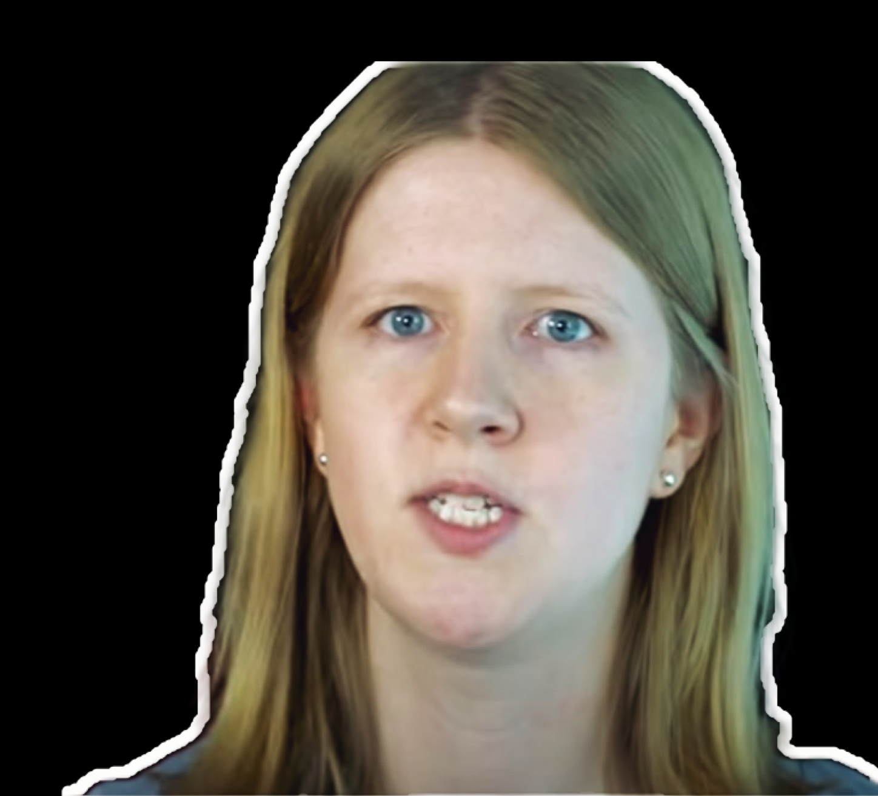
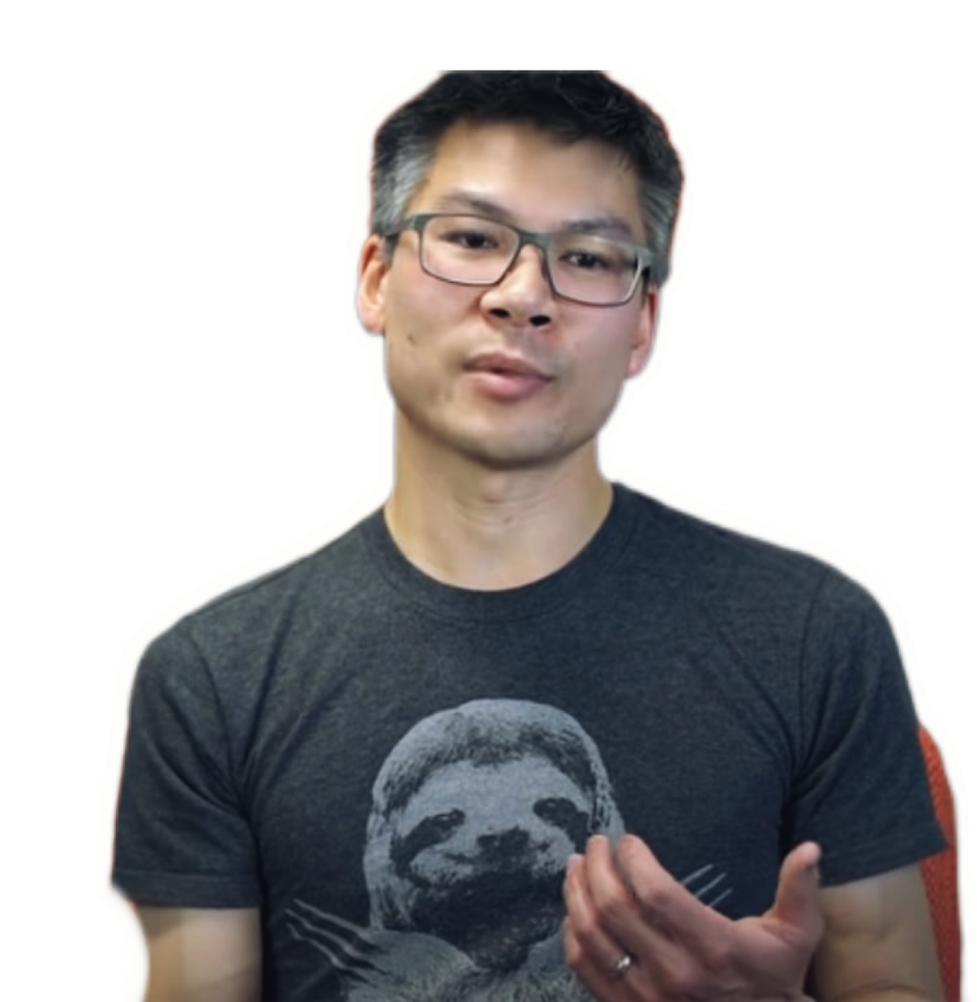
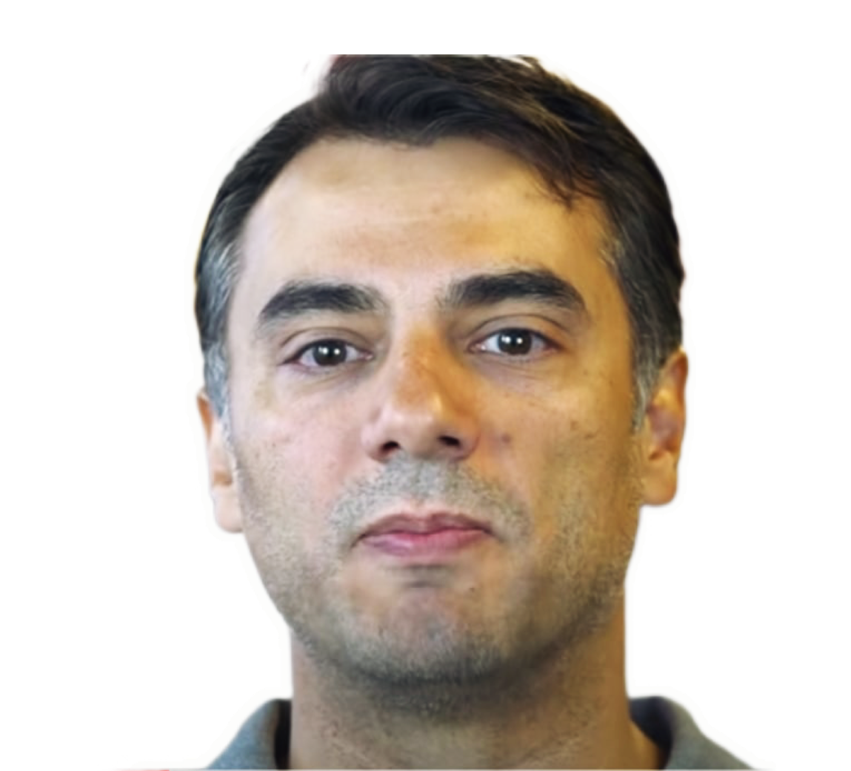
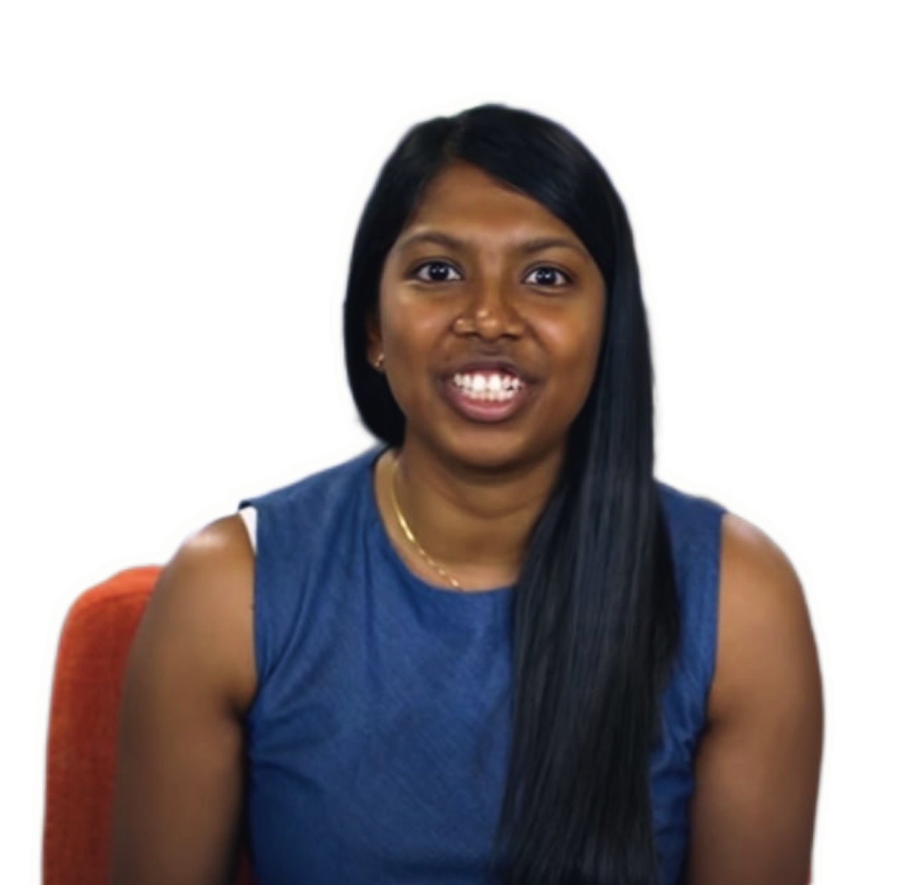
You have to be willing to let all your preconceived notions be broken.
We are always looking for the leapfrog innovation.
There was just a vibe that I wanted to be a part of.
That's a lot of impact that you can have.
You are going to have to make your own rules.
You can really go beyond your skill set and push the boundaries.
There are so many teams across Google that have amazing expertise.

Slide 10
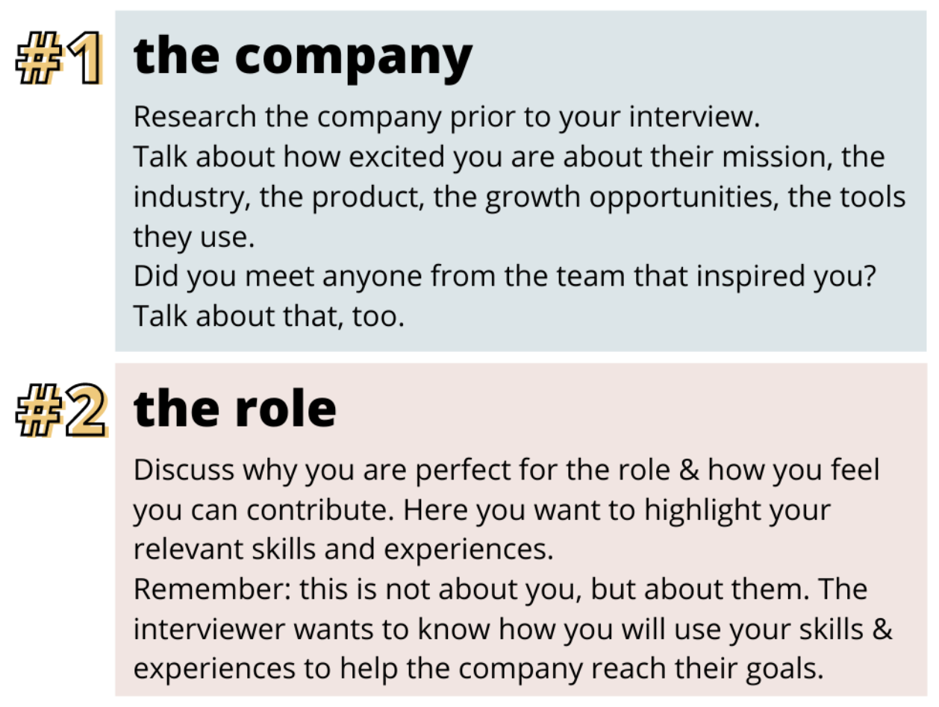
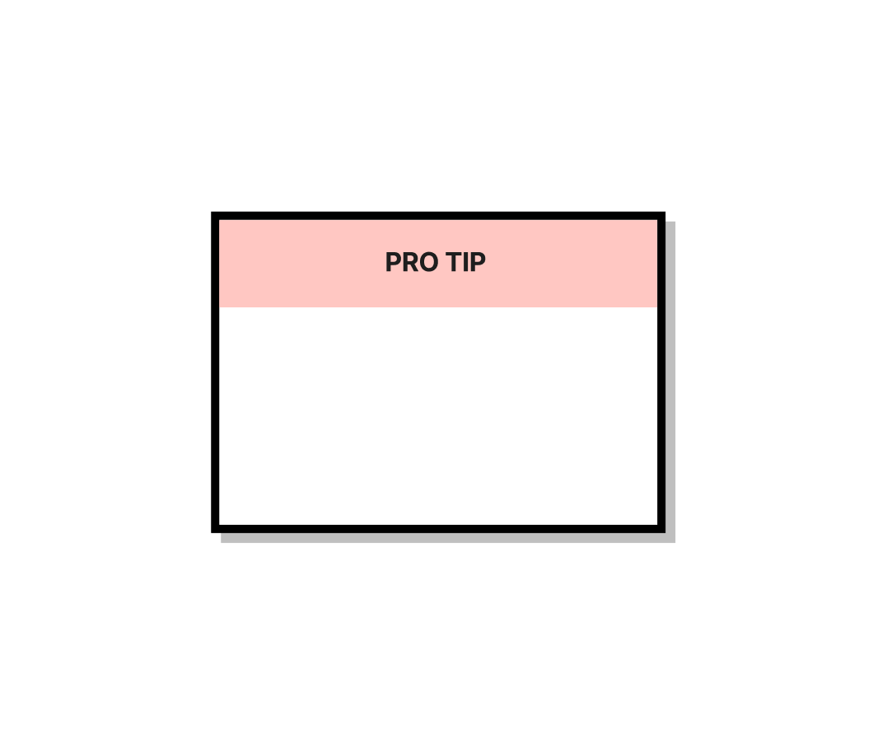
How to answer:
Why do you want to work for Google?
Choose 1-2 similar values and explain why they are important for you

Slide 11
Example:
“Your business is a leader in the developer tools space, moreover when I was looking online, I noticed that the reviews of your company from current and former employees are great.
I especially like how supporting new ideas is part of the corporate culture.
I often have random ideas on how to improve my work and I’d love to work for a business that is so supportive of anyone with an idea, irrespective of their experience.”

Slide 12

Choose 1-2 values that you have in common with your dream company and explain why.
We want to work with great people
Technology innovation is our lifeblood
Be actively involved; you are Google
Don't take success for granted
Do the right thing; don't be evil
Useful vocabulary
The most crucial thing for me is…
At the top of my list of priorities is…
The most important thing for me is…
What’s really important for me is…
I especially like…
I’d love to work for a business that is…
I admire….

Slide 13
Homework
Answer the interview question Why do you want to work here?
(see pr. slides) and send to your teacher for proofreading
Learn the glossary for the next lesson
Revise the glossary and presentation for this lesson
Do the task: https://wordwall.net/ru/resource/34877616/working-at-google
Find out more about:
What's it like to work at Google?

Slide 14
What can you do after this lesson?
I learned:
How to answer the questions:
Why do you want to work here?
What is the most important to you in a job?
Notes:
Развернутый комментарий

Slide 15
Thank you!

